Slide 1
Sentiment Analysis of YouTube Comments: A Comprehensive Study of Machine Learning Models Paper ID: 5500
Most. Jannatul Firdousi Zoti, Maruf Rahman, Syed Shafin Ahmed,
Asa-ad Mohammad Akib, Sadman Sadik Khan
Daffodil International University

Slide 2
Contents
Introduction
Motivation
Literature Review
Methodology
Results
Future scope
Conclusion

Slide 3
Introduction
YouTube, with over 2.7 billion active users and an extensive repository of videos, stands as a major platform for content dissemination and public engagement. The comment sections serve as a valuable source of user feedback, opinions, and sentiments, offering critical insights for content creators, marketers, and researchers. However, the vast volume and unstructured format of these comments—characterized by informal language, slang, emojis, sarcasm, and multilingual usage—present considerable challenges for manual analysis.
This study seeks to address the challenges of analyzing YouTube comments by evaluating and comparing the performance of various machine learning algorithms on a large, preprocessed dataset. The objective is to identify the most effective model for automated sentiment detection, thereby providing deeper insights into audience perceptions and supporting more informed content strategy decisions.

Slide 4
Motivation
The primary objective of this research is to evaluate multiple machine learning models systematically to identify the most effective approach for sentiment classification on YouTube comment data.
This work has significant applications including enhancing content strategy by understanding audience emotions, enabling real-time feedback analysis through automated sentiment tracking, and improving personalization in recommendation systems.

Slide 5
Literature Review
Reference | Authors | Datasets | Best Performing Algorithm | Best Accuracy
[5] | A Bermingham et al. | 122,011 comments from the user profile | Lexicon-Based Sentiment Analysis using SentiWordNet | Relies on qualitative evaluation
[7] | A Bessi et al. | 17,452 YouTube videos and 21,077 Facebook posts | Multinomial Logistic Model | 80%
[8] | C Dhaoui et al. | 850 top consumer-generated comments from 83 luxury fashion brands | Lexicon-Based Approach using LIWC2015 and Machine Learning Approach using the RTextTools package | F-score: Positive Sentiment = 0.83 Negative Sentiment = ~0.46
[10] | AAL Cunha et al. | 1,000 comments from YouTube | Deep Neural Network Model | Category 1, Video 1 = 84% test Accuracy
[13] | R Singh et al | 1500 citation sentences | SVM | micro-F = 87% macro-F = 49%

Slide 6
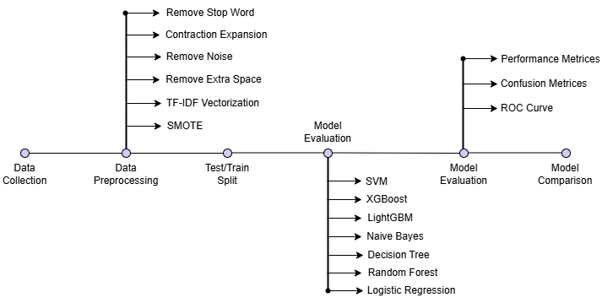
Methodology

Slide 7
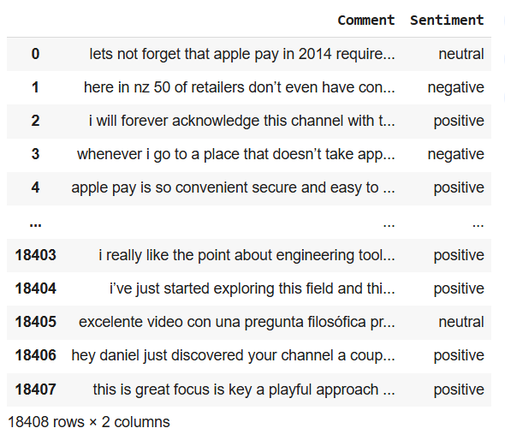
Methodology
Data Collection: Gathered 18,408 labeled
YouTube comments from Kaggle, distributed
as Positive (11,432), Neutral (4,638), and
Negative (2,338) sentiments.

Slide 8
Methodology
Preprocessing: Involves—
Removal of stopwords,
Noise reduction,
Lemmatization
Feature extraction via Term Frequency-Inverse Document Frequency (TF-IDF).
SMOTE is applied to mitigate imbalance by synthetically augmenting underrepresented classes.

Slide 9
Methodology
Model Training: Trained seven well-established classifiers—
Logistic Regression
Decision Tree
Random Forest
Support Vector Machine
Naïve Bayes
XGBoost
LightGBM
Evaluation: Performance assessed by precision, recall, F1-score, and overall accuracy metrics to comprehensively quantify classification effectiveness.

Slide 10
Methodology
Performance Analysis of the models
Models | Precision | Recall | F1-score | Accuracy
Logistic Regression | 82% | 82% | 82% | 81.15%
Random Forest | 88% | 88% | 88% | 88.31%
Decision Tree | 80% | 80% | 80% | 80.46%
Naïve Bayes | 75% | 75% | 75% | 75.04%
SVM | 82% | 82% | 82% | 82.03%
XGBoost | 78% | 78% | 78% | 77.57%
LightGBM | 79% | 79% | 79% | 79.06%

Slide 11
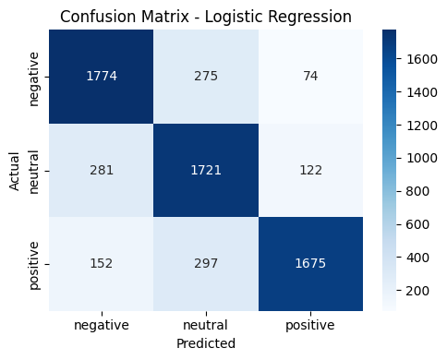
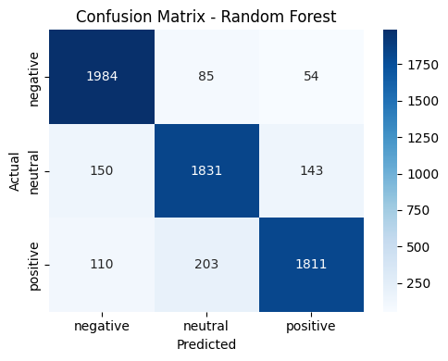
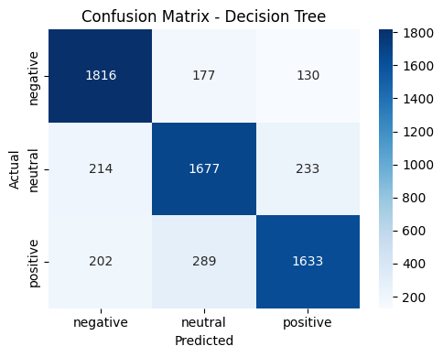
Results
0

Slide 12
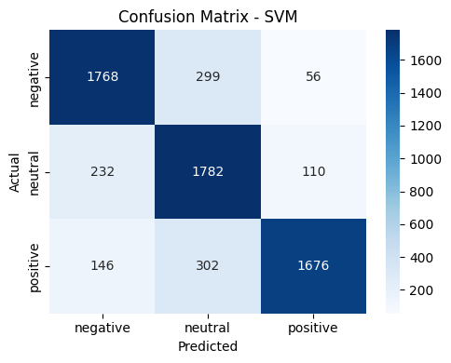
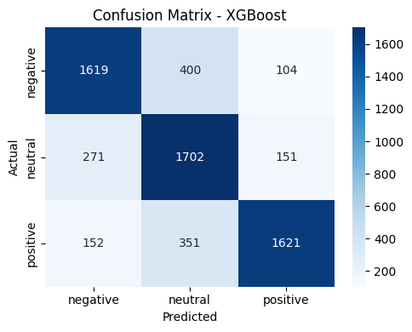
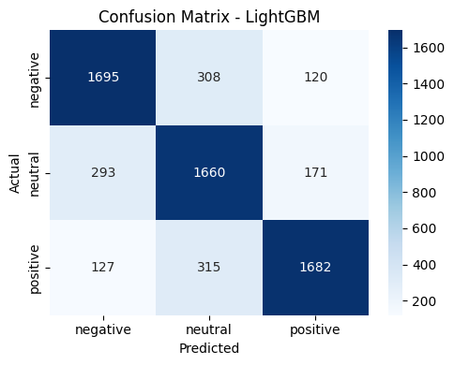
Result
0

Slide 13
Result
Model Performance: Random Forest showed the best performance with an 88.31% accuracy rate.
Logistic Regression, SVM, Decision Tree: Displayed good generalization capabilities with accuracies close to training performances.
Analysis: The Random Forest emerged as the top-performing model, demonstrating superior generalization and balanced metrics across all categories. Evaluation also included analysis of confusion matrices confirming class-wise discrimination accuracy, and AUC-ROC curves with values exceeding 0.90 for all sentiment classes, underscoring model robustness.

Slide 14
Result
Comparison among existing works
Author | Dataset Used | Language | Best Model & Accuracy
A Bermingham et al. [5] | 122,011 comments from the user profile | English | Lexicon-Based Sentiment Analysis using SentiWordNet (Relies on qualitative evaluation)
A Bessi et al. [7] | 17,452 YouTube videos and 21,077 Facebook posts | English | Multinomial Logistic Model (80%)
C Dhaoui et al. [8] | 850 top consumer-generated comments from 83 luxury fashion brands | English | The Lexicon-Based Approach using LIWC2015 and RTextTools Positive Sentiment (0.83), Negative Sentiment (~0.46)
AAL Cunha et al. [10] | 1,000 comments from YouTube | English | Deep Neural Network Model (84%)
R Singh et al. [13] | 1500 citation sentences | English | SVM (micro-F = 87%, macro-F = 49%)
Proposed Model | 18,408 YouTube comments | English | Random Forest (88.31%)

Slide 15
Future Scope
Deep Learning Architectures: Implementation of LSTM and BiLSTM recurrent models, and state-of-the-art transformer models like BERT to capture contextual nuances and long-range dependencies.
Multi-Language Capability: Expanding analysis to handle multi-lingual YouTube comments, addressing the global audience diversity.
Cross-Platform Integration: Aggregating datasets across social media platforms such as Facebook, Twitter, and TikTok to develop more generalized sentiment classifiers.
Real-Time Analytics: Developing an interactive dashboard providing instantaneous sentiment feedback to content creators, enhancing content curation and audience engagement.

Slide 16
Conclusion
This study analyzed over 18,000 YouTube comments to systematically evaluate seven machine learning models through rigorous preprocessing including TF-IDF vectorization and SMOTE balancing techniques. The Random Forest classifier demonstrated the most effective performance with 88.31% accuracy and consistent precision and recall across positive, neutral, and negative sentiment classes.
The outcomes substantiate the feasibility of deploying interpretable and scalable ML-based sentiment classifiers in practical settings, particularly helpful for content optimization and audience insight extraction. The methodology and findings pave the way for future advancements incorporating deep learning and multi-lingual capabilities.

Slide 17
References
[1] Goodrow, Cristos (February 27, 2017). "You know what's cool? A billion hours". Archived from the original on August 6, 2020. Retrieved April 19, 2021 – via YouTube.
[2] Loke Hale, James (May 7, 2019). "More Than 500 Hours Of Content Are Now Being Uploaded To YouTube Every Minute" TubeFilter. Los Angeles, CA. Archived from the original on January 5, 2023. Retrieved June 10, 2019.
[3] Neufeld, Dorothy (January 27, 2021). "The 50 Most Visited Websites in the World". Visual Capitalist. Archived from the original on December 10, 2021. Retrieved December 6, 2021.
[4] Germain, Thomas (February 13, 2025). "How a computer that 'drunk dials' videos is exposing YouTube's secrets". BBC. Retrieved February 13, 2025.
[5] Bermingham, Adam, et al. "Combining social network analysis and sentiment analysis to explore the potential for online radicalisation." 2009 International Conference on Advances in Social Network Analysis and Mining. IEEE, 2009.
[6] Madden, Amy, Ian Ruthven, and David McMenemy. "A classification scheme for content analyses of YouTube video comments." Journal of documentation 69.5 (2013): 693-714.
[7] Bessi, Alessandro, et al. "Users polarization on Facebook and Youtube." PloS one 11.8 (2016): e0159641.
[8] Dhaoui, Chedia, Cynthia M. Webster, and Lay Peng Tan. "Social media sentiment analysis: lexicon versus machine learning." Journal of Consumer Marketing 34.6 (2017): 480-488.
[9] Aung, Khin Zezawar, and Nyein Nyein Myo. "Sentiment analysis of students' comment using lexicon based approach." 2017 IEEE/ACIS 16th international conference on computer and information science (ICIS). IEEE, 2017.
[10] Cunha, Alexandre Ashade Lassance, Melissa Carvalho Costa, and Marco Aurélio C. Pacheco. "Sentiment analysis of youtube video comments using deep neural networks." Artificial Intelligence and Soft Computing: 18th International Conference, ICAISC 2019, Zakopane, Poland, June 16–20, 2019, Proceedings, Part I 18. Springer International Publishing, 2019.

Slide 18
References
[11] Xu, Guixian, et al. "Sentiment analysis of comment texts based on BiLSTM." Ieee Access 7 (2019): 51522-51532.
[12] Aribowo, Agus Sasmito, et al. "Cross-domain sentiment analysis model on Indonesian YouTube comment." International Journal of Advances in Intelligent Informatics 7.1 (2021).
[13] Singh, Ritika, and Ayushka Tiwari. "Youtube comments sentiment analysis." International Journal of Scientific Research in Engineering and Management (IJSREM) 5.5 (2021): 1-11.
[14] Sarlan, Aliza, Chayanit Nadam, and Shuib Basri. "Twitter sentiment analysis." Proceedings of the 6th International conference on Information Technology and Multimedia. IEEE, 2014.
[15] Bhuiyan, Hanif, et al. "Retrieving YouTube video by sentiment analysis on user comment." 2017 IEEE International Conference on Signal and Image Processing Applications (ICSIPA). IEEE, 2017.
[16] Uryupina, Olga, et al. "SenTube: A Corpus for Sentiment Analysis on YouTube Social Media." LREC. 2014.
[17] Rahab, Hichem, Abdelhafid Zitouni, and Mahieddine Djoudi. "SANA: Sentiment analysis on newspapers comments in Algeria." Journal of King Saud University-Computer and Information Sciences 33.7 (2021): 899-907.
[18] Devika, M. Devi, Cª Sunitha, and Amal Ganesh. "Sentiment analysis: a comparative study on different approaches." Procedia Computer Science 87 (2016): 44-49.
[19] Hussein, Doaa Mohey El-Din Mohamed. "A survey on sentiment analysis challenges." Journal of King Saud University-Engineering Sciences 30.4 (2018): 330-338.
[20] Prabowo, Rudy, and Mike Thelwall. "Sentiment analysis: A combined approach." Journal of Informetrics 3.2 (2009): 143-157.

